Slide 1
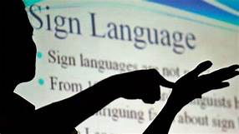
CONVERSATION ENGINE FOR DEAF AND DUMB
BY TEAM 17:
MONIKA K J
NANDITHA K N
SPOORTHY M N
NAVYA GADINA
NETHRAVATHI B

Slide 2
CONTENTS:
1.INTRODUCTION
2.EXISTING PROBLEM
3.PROPOSED SOLUTION
4.BLOCK DIAGRAM
5.IMAGE RECOGNITION
6.RESULT
7.ADVANTAGES AND DISADVANTAGES
8.CONCLUSION

Slide 3
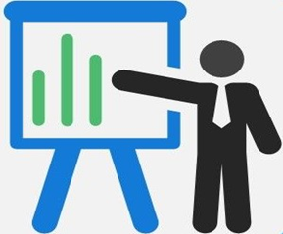
1.INTRODUCTION
In our society we have people with disabilities. The technology is developing day by day but no significant developments are undertaken for the betterment of these people. About nine billion people in the world are deaf and dumb. Deaf people around the world communicate using sign language as distinct from spoken language in their everyday a visual language that uses a system of manual, facial and body movements as the means of communication. Gesture recognition enables computer to understand human actions and also acts as an interpreter between computer and human. Gestures are performed by deaf and dumb community to perform sign language. This community used sign language for their communication when broadcasting audio is impossible, or typing and writing is difficult, but there is the vision possibility.

Slide 4
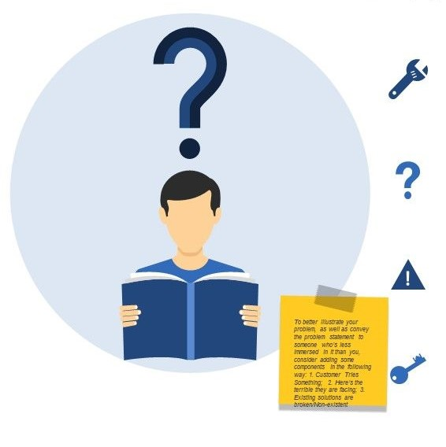
2. EXISTING PROBLEM:
Communications between deaf-mute and a normal person have always been a challenging task. It is very difficult for mute people to convey their message to normal people. Since normal people are not trained on hand sign language. In emergency time conveying their message is very difficult. Human hand has remained a popular choice to convey information in situations where other forms like speech cannot be used. Text Conversion System with Hand Gesture Recognition and translation will be very useful to have proper conversation between a normal person and impaired person in any language.

Slide 5
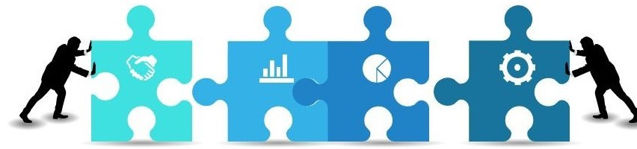
3.PROPOSED SOLUTION
We are making use of convolution neural network to create a model which is trained on different hand gestures. Opencv, a python library in this model to detect the hand gestures. This model enables deaf and dumb people to convey their information using signs which gets converted to human understandable language.

Slide 6
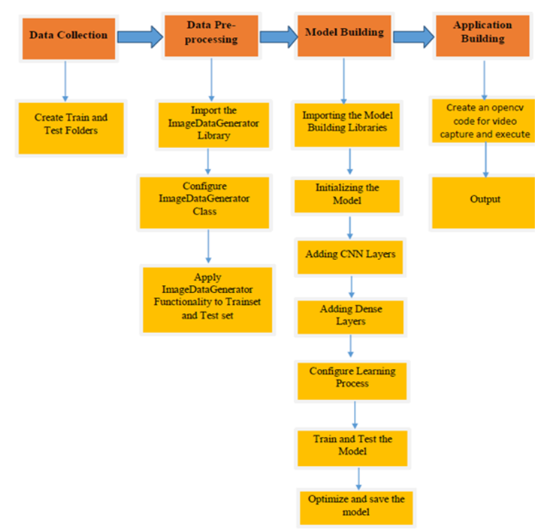
4.BLOCK DIAGRAM

Slide 7
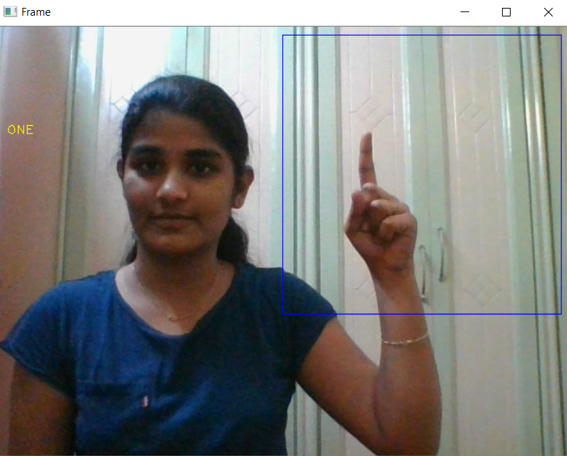
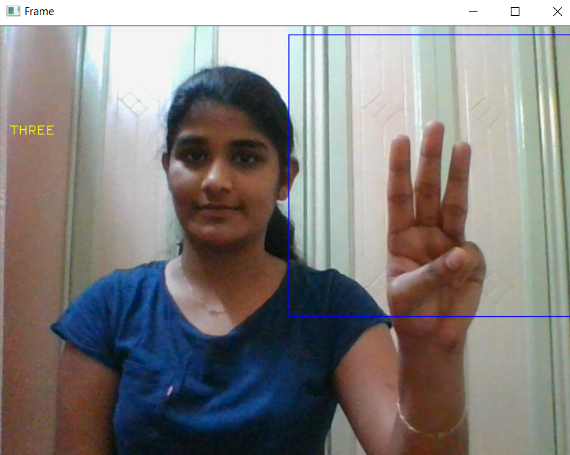
6.RESULT: CNN algorithm is used to predict its performance. The results show that, 97% accuracy is achieved. And using opencv through video capture we have displayed the output which recognizes the hand gestures and displays the output.

Slide 8

7. ADVANTAGES AND DISADVANTAGES Advantages: 1. Easy and simple User Interface for the deaf and dumb people who wants to recognize the signs. 2. CNN give the accurate result of the prediction up to 97% which is the algorithm we used for prediction. 3. User friendly and low cost 4. It can work in real time and predict as soon as the necessary details for prediction are given to the model. Disadvantages: 1. Datasets challenges can occur. 2. It easily generate anatomically incorrect examples.

Slide 9
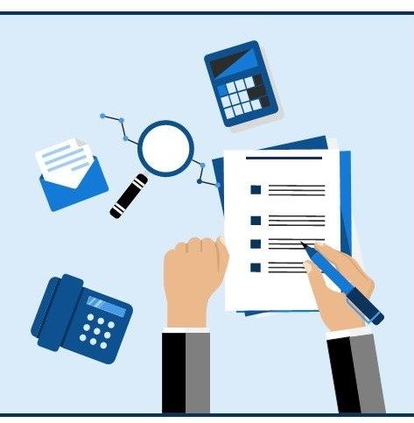
8.CONCLUSION
This application helps the deaf and dumb person to communicate with the rest of the world using sign language. Suitable existing methods are integrated in this application. Computer recognition of sign language is an important research problem for enabling communication with hearing impaired people. The Computer based intelligent system will enable deaf & dumb people significantly to communicate with all other people using their natural hand gestures.

Slide 10

THANK YOU

